Slide 1

Product Data Mining: Results and Observations
Blackwell
Electronics
April 16, 2019
Rory Langran
Itoro Etuks
Mehmet Erden
Raju Ramasamy

Slide 2

Introduction Data Classification Predictive Modelling Potential Applications
Blackwell
Electronics

Slide 3
Introduction
Data mining has the potential to:
Find hidden patterns as well as dispel myths
Determine what really works
What is most likely to work in the future
This data mining exercise was designed to explore and analyze the following areas:
Identify any relationships between different categories of customer transaction data
Predict the profitability of Blackwell’s new products considered by Sales Team?
Discover potential applications that could leverage data mining for other areas of Blackwell’s eBusiness?

Slide 4
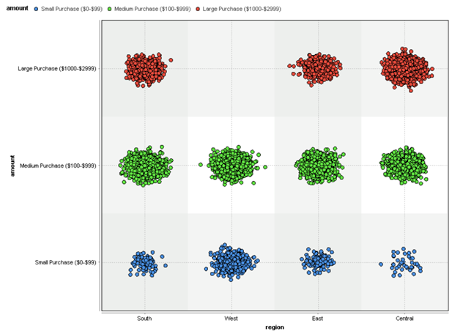
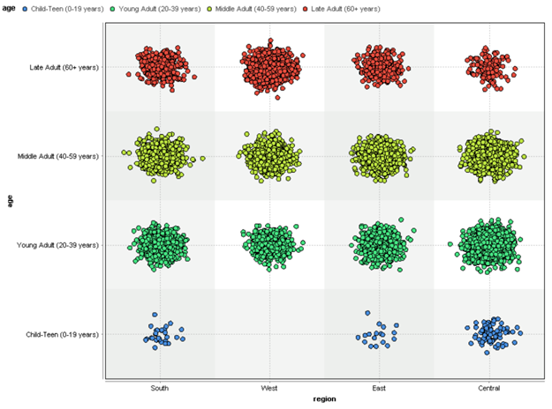
Observations of Customer Transaction Data
Spend Amount vs Region
Customer Age vs Region
West has no spend over $999
South has highest median spend
West has lowest median spend
West has no cust under 20 yrs old
South Region – Highest Median Spend of $1361/transaction
West Region – No customers under 20 years of age
West Region – Highest Median Spend of $248/transaction
Central / East Region – Fewer customers 60 years and older
West Region – Has no purchase over $999/transaction
No other demographic data is able to accurately predict customer age
There were no In-Store purchases in the West Region

Slide 5
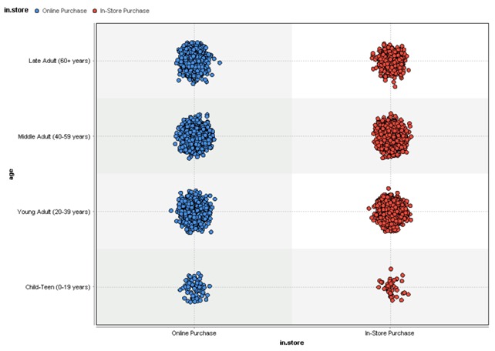
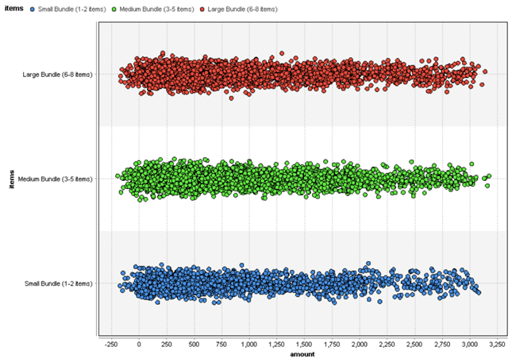
Observations of Customer Transaction Data
Customer Age vs Online / In-Store
# of Items vs Spend Amount
No meaningful correlation between age of customer and online vs in-store purchasing
No meaningful relationship between # of items purchased and spend amount
No correlation between the other attributes and online/in-store purchases
There were no In-Store purchases over $2,000

Slide 6
Classifying Customer Transaction Data
Key takeaways from data mining of customer data:
Customer Age cannot be accurately predicted using any of the other variables
There is no meaningful correlation between Online/In-Store sales and any other variable
No meaningful relationship between number of items purchased and amount spent
Decision tree classifier produced the highest accuracy (80%) out of four Decision Tree classifiers to predict if a purchase would be Online or In-Store

Slide 7
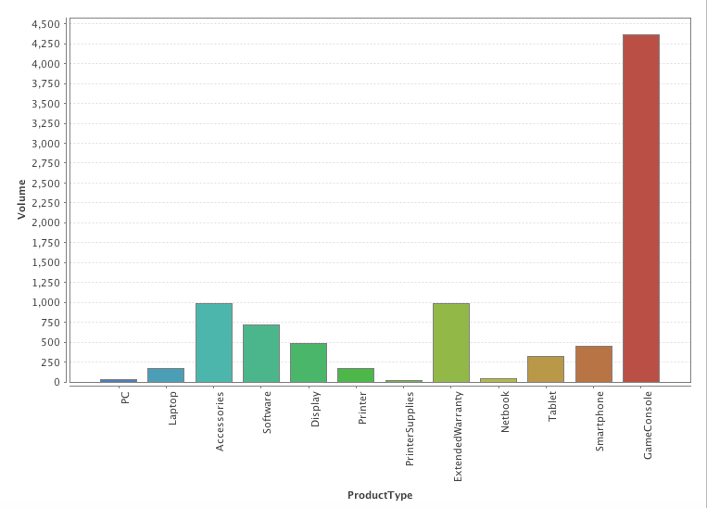
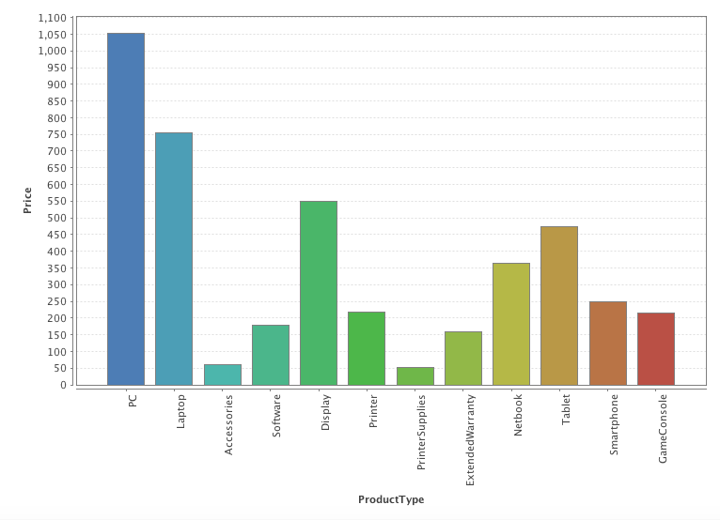
Predictive Modelling
EXISTING PRODUCTS
SALES VOLUME
PRICE

Slide 8
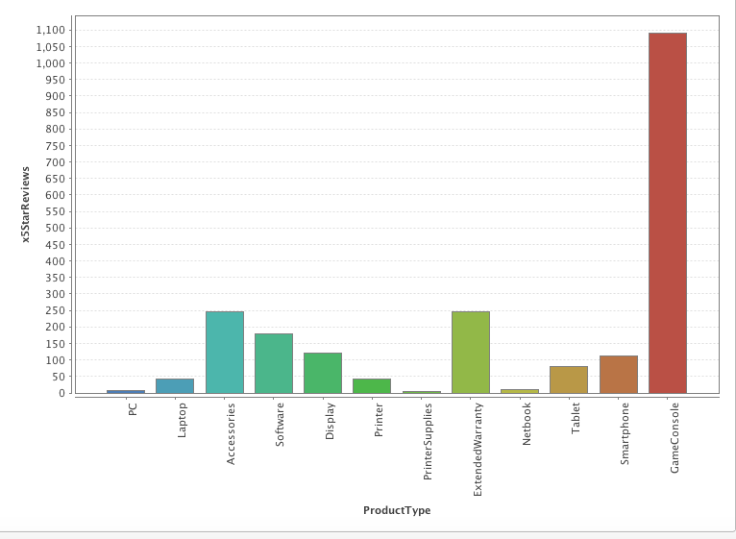
Predictive Modelling
EXISTING PRODUCTS
Feature Selection
Two pairs of collinear features
1 & 2 Star Reviews / 3 & 4 Star Reviews
Only one feature from each of the collinear pairs were used.
Features with very low correlation were removed
5 Star Reviews
Final List of Features
Negative Service Review, Positive Service Review, Price, Profit Margin, Recommendation Index, 1-3-5 Star Reviews
Predictive Models
SVM method was selected
 | KNN (k = 2) | SVM (C = 55) | GBT (Trees = 100)
RMSE | 580.848 | 415.583 | 743.931
Squared Correlation | 0.891 | 0.913 | 0.901

Slide 9
5 New Products By Profitability
Predictive Modelling
Product Type | Product # | Brand Name | Price | Profit margin | Predicted Sales Volume | Predicted Profit
Tablet | 187 | Amazon | $199.00 | 20% | 9,174 | $ 365,107.05
Tablet | 186 | Apple | $629.00 | 10% | 1,481 | $ 93,127,29
Laptop | 176 | Razer | $1,999.00 | 23% | 96 | $ 44,337.47
Netbook | 180 | Acer | $329.00 | 9% | 1,445 | $ 42,788.38
Game Console | 199 | Sony | $249.99 | 9% | 1,793 | $ 40,347.61

Slide 10

Potential Applications for Data-Driven Decisions
Product Recommenders to Online Customers:
Data mining of customer purchasing data to generate recommendations based on popular choices from similar customers
Identify potential opportunities for new product releases
Combine recommendation data with other data in order to increase data mining opportunities throughout the company
Use recommendations to create targeted promotional messages to customers
Amazon Recommendation Engine:

Slide 11

Questions?

